Slide 1
Subgroup Analyses

Slide 2
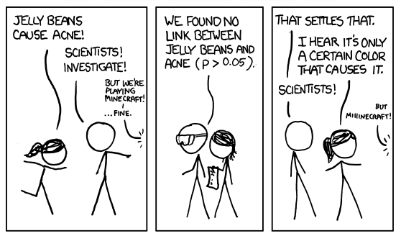
Subgroup Analyses – What is the problem?
https://xkcd.com/882/
FoS: Medical Affairs training

Slide 3
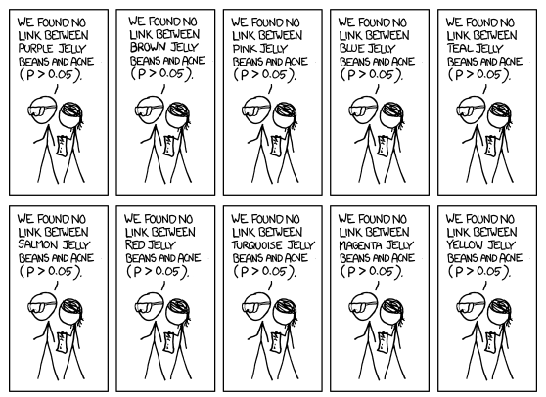
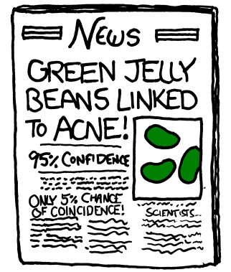
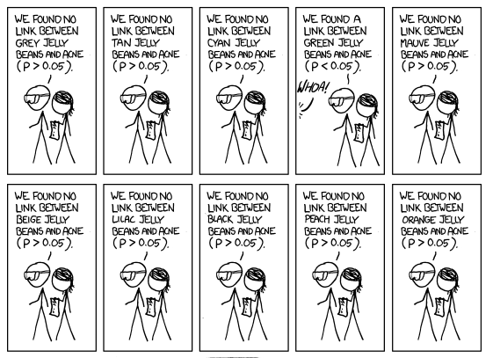
Subgroups Analyses – What is the problem?
https://xkcd.com/882/
FoS: Medical Affairs training

Slide 4



Subgroup analyses: What are they?
Subgroup analyses divide the overall study population into subgroups, depending on a given demographic or baseline characteristic.
✓
✗
Subgroup A
✓
Subgroup B
FoS: Medical Affairs training

Slide 5




Subgroup Analyses – Why Do We Need Them?
Do we still see a positive benefit-risk in patients with hepatic impairment?
Is this drug cost-effective in patients with severe disease?
I’m a 53 year-old Asian woman. What will happen if I take this medicine?
Physicians
Will this medicine benefit my patient?
Payers
Patients
Regulators
FoS: Medical Affairs training

Slide 6
What do we need to consider when interpretting subgroup data?
General Principles
Heterogeneity
  How similar/different are patients in the trial with respect to important prognostic/predictive factors?
Consistency
  Is the benefit/risk in the overall study population also observed across important subgroups?
Credibility
  Can observed subgroup differences be relied on for decision-making (e.g. regulator approval, prescribers)?
Biological Plausibility
  Is the effect predicted by clinical, pharmacological, mechanistic considerations (including external sources)?
Replication
  Is the effect also seen in other trials (internally or externally)? Also, if a subgroup effect is real, it is likely to manifest itself across all closely related outcomes
Sample Size
  Were the groups sufficiently large to be representative?
FoS: Medical Affairs training

Slide 7
Case Study: Leronlimab
Leronlimab
A treatment in development for COVID-19
CD10: 86 subjects, mild to moderate disease
CD12: 394 subjects, severe respiratory symptoms associated with COVID-19 (pivotal Ph3 study)
CD10 did not meet its primary endpoint, or any of its secondary endpoints
CD12 also failed to achieve its primary endpoint.
FoS: Medical Affairs training

Slide 8
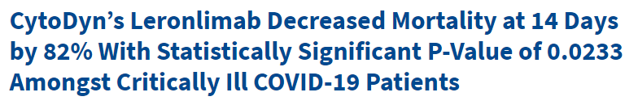
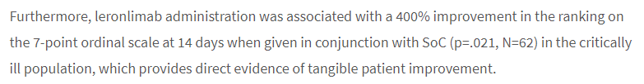
Case Study: Leronlimab
Press release: 30th March 2021
FoS: Medical Affairs training

Slide 9
FDA statement
17th May 2021
“….If the analyses of the primary and secondary endpoints do not support conclusions of the medicine’s benefit, then FDA considers subgroup analyses to be exploratory, meaning they may inform the design of future trials, but do not support reliable conclusions about the medicine’s benefit. Focusing on only the most favourable of many subgroup analyses, even if the subgroups are pre-specified, can lead to overestimating the evidence of benefit, because regardless of a drug’s true efficacy, some analyses are likely to appear favourable by chance when a large number of analyses are conducted.”
FoS: Medical Affairs training

Slide 10
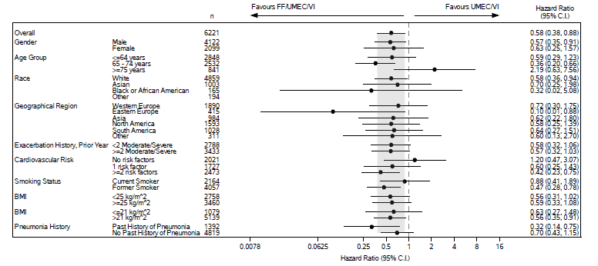
Example: Trelegy COPD - IMPACT study
Forest Plot of Hazard Ratios for Time to On-Treatment All Cause Mortality
FoS: Medical Affairs training

Slide 11
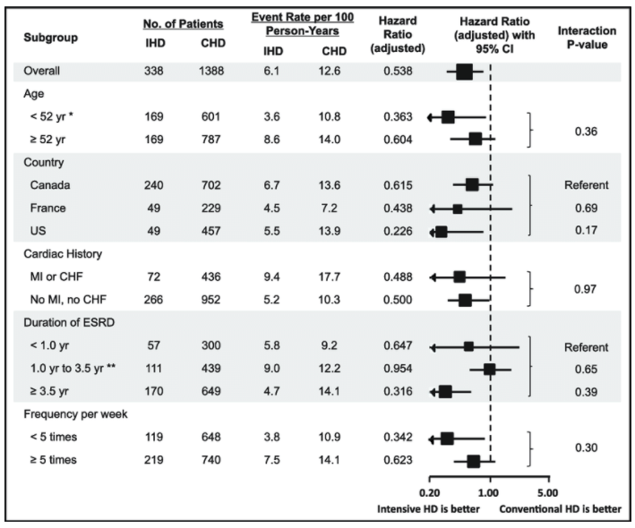
Interaction Tests
A p-value from an “interaction test” has the following problems:
Sensitivity (lack of statistical power):
  We may not detect differences even if they exist.
Selectivity (spurious results):
  We may detect false positives.
FoS: Medical Affairs training

Slide 12
Subgroup Analyses – Statistician’s Perspective
- Subgroups may not be independent. For instance, we may observe a larger treatment effect in women compared to men. However, if the men were generally younger than the women, age rather than sex might explain the interaction. We need to consider baseline characteristics within each subgroup.
- As subgroups are generally exploratory, we strongly recommend p-values are NOT presented for subgroup analyses. Treatment estimates and confidence intervals are sufficient for interpretation.
FoS: Medical Affairs training

Slide 13
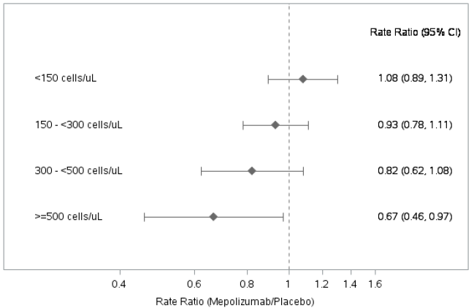
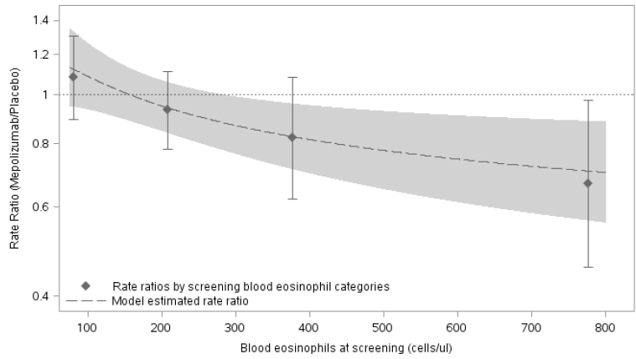
Some Alternative Approaches to Subgroup Analysis
Case Study
Effect of Baseline Blood Eosinophil Count (BEC) on Asthma Exacerbations
If the covariate of interest is continuous, a subgroup analysis requires categorisation based on pre-defined threshold values:
However, sometimes a more informative approach is to use a statistical model, including the covariate on a continuous scale:
FoS: Medical Affairs training

Slide 14






So what CAN we say?!
Subgroup analyses are useful for:
Identifying the right population for our drug
Informs treatment guidelines
Which helps inform physicians on which drug to prescribe for an individual
Identify treatment gaps to inform future research

Slide 15
Key Messages
Subgroup Analyses
What do you need to do?
Subgroup analyses tend to be exploratory in nature. They are useful to show consistency of effect or to generate a hypothesis for a responder group (which would then require additional research)
Treat subgroup results with caution. Results should always be put into context with other data (either other results within the study or results from other studies).
However, they can lead us to false claims and conclusions if multiplicity is not properly accounted for
Transparency needed when presenting our results
Beware of overinterpreting small subgroups!
If in doubt: Talk to your Statistician!
Fundamentals of Statistics: Multiplicity, Subgroups & Missing Data Webinar

Slide 16
A Case Study
The Scott Harkonen Case

Slide 17
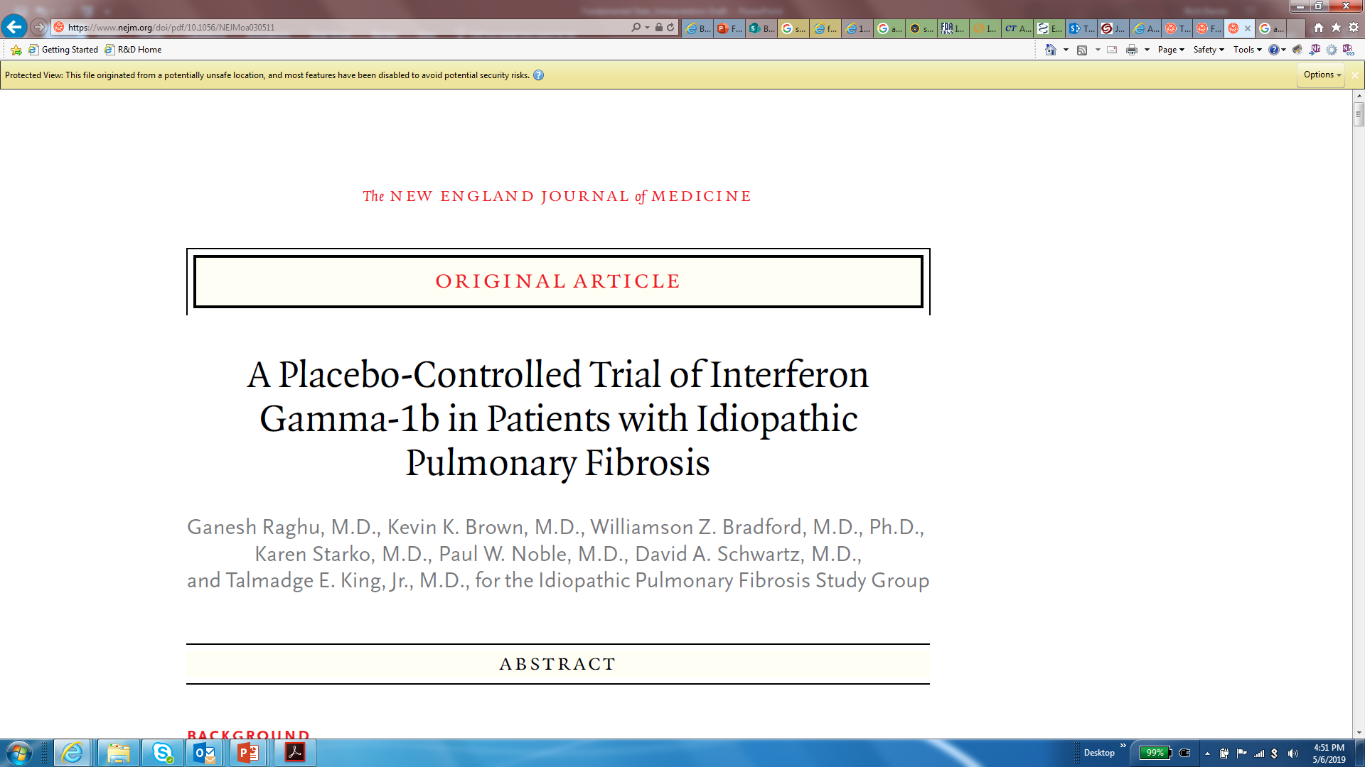
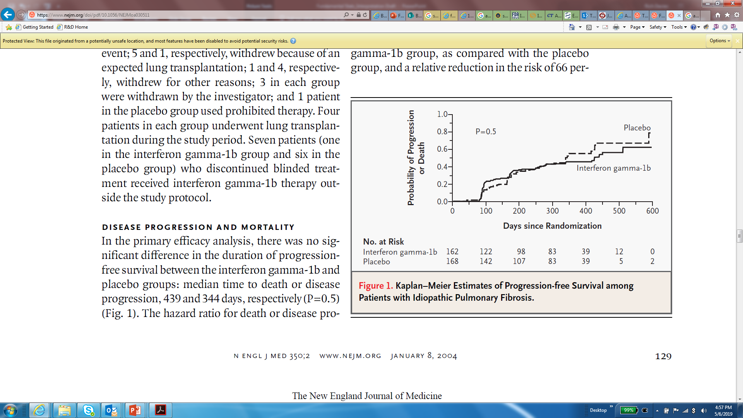
The Scott Harkonen Case
Phase 3 Study of ActImmune in IPF (an additional indication)
Primary Endpoint: Progression-Free Survival at 1 year
Planned sample size of 306 patients (actual 330)
  94% power (assuming a 50% reduction in PFS)
Primary Result (study unblinded in August 2002)
  No difference in primary endpoint (HR=0.9; p=0.5)
FoS: Medical Affairs training
N Engl J Med 2004;350:125-33

Slide 18
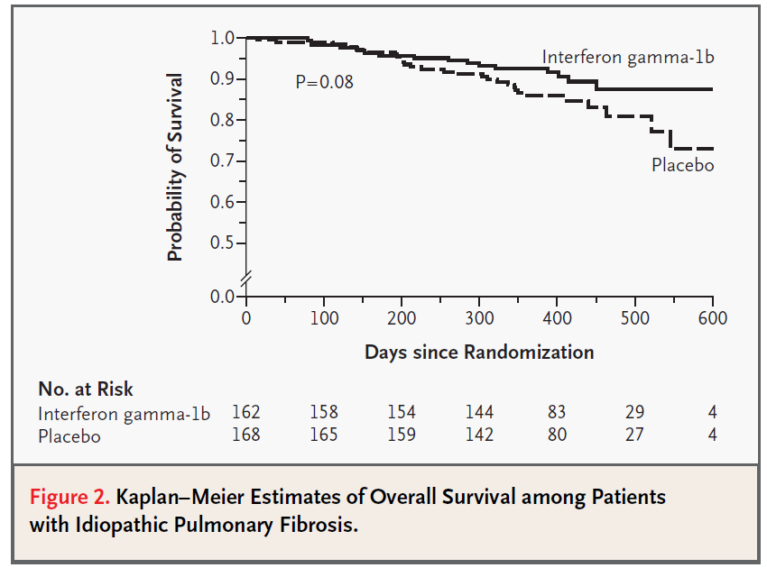
Let the P-Hacking Begin
A trend in mortality benefit was observed in ITT population
  HR=0.6; p=0.08; Active group: 10% (16/162); Placebo group: 17% (28/168)
In August 2002, Intermune CEO Scott Harkonen “instructed [his staff] to conduct additional analyses in an effort to ascertain whether Actimmune® might be efficacious for certain subgroups of the patient population.”
  # U.S. District Court Memorandum & Order; June 4, 2009
  (http://www.fdlawblog.net/wp-content/uploads/archives/docs/harkonen.pdf)
N Engl J Med 2004;350:125-33
FoS: Medical Affairs training

Slide 19
Eureka!!!
In patients with mild-to-moderate disease:
  Mortality HR=0.3; p=0.004; Active group: 5% (6/126); Placebo group: 16% (21/128)
So, to recap:
In a phase 3 trial with a failed primary endpoint…
… a post-hoc analysis …
… of a secondary endpoint …
… in a subgroup of patients …
… had the result of p<0.05.
What comes next?
FoS: Medical Affairs training

Slide 20
Confirmation Bias at Work
Press Release: August 28, 2002
INTERMUNE ANNOUNCES PHASE III DATA DEMONSTRATING SURVIVAL BENEFIT OF ACTIMMUNE IN IPF
- Reduces Mortality by 70% in Patients with Mild to Moderate Disease
“… preliminary data … demonstrate a significant survival benefit in patients with mild to moderate disease… (p=0.004)”. These data confirm the survival benefit seen in the Phase II trial presented at…”
“… Actimmune may extend the lives of patients …” - Scott Harkonen, CEO
“… Actimmune should be used early in the course of this disease to realize the most favorable long-term survival benefit.” – Dr. Ganesh Raghu, Trial PI
  https://www.sec.gov/Archives/edgar/data/1087432/000091205702033878/a2088367zex-99_1.htm
FoS: Medical Affairs training

Slide 21
Things Are Looking Up
Actimmune’s sales increased from $11M in 2000 to $141M in 2003
  Mostly due to off-label treatment in IPF
Phase 3 study INSPIRE started in Dec 2003 to convince FDA of the mortality benefit
  Primary endpoint: Overall Survival (3-year mortality)
  600 patients randomized to ActImmune or Placebo
  90% power (assuming a 50% reduction in mortality) (24% for Placebo to 12% for ActImmune)
FoS: Medical Affairs training

Slide 22
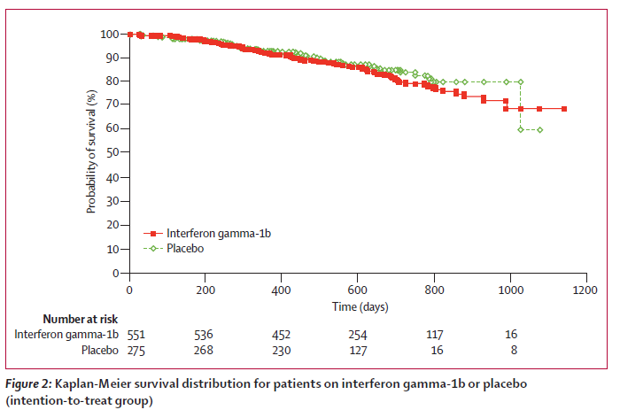
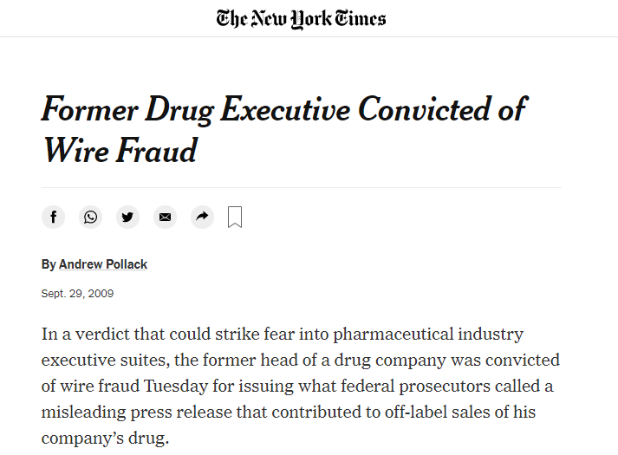
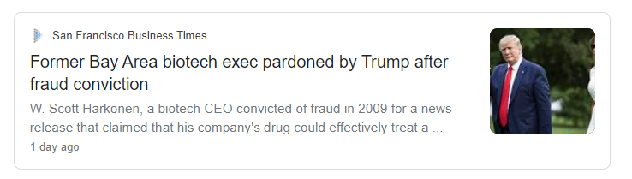
Something Just Hit The Fan
2007
InterMune discontinues Phase 3 INSPIRE trial of Actimmune in Idiopathic Pulmonary Fibrosis
2009
Scott Harkonen was convicted for fraud
A jury ruled he made “false and misleading statements” in the Aug 2002 press release with “intent to defraud and mislead”
2021
Former Intermune CEO Harkonen Receives Trump Pardon
“Dr. Harkonen looks forward to returning to medicine.”
Fundamentals of Statistics: Multiplicity, Subgroups & Missing Data Webinar

Slide 23

Knowledge Check
CHATBOX
What could InterMune have done differently?
  Ask FDA for advice on their subgroup data
  Wait for Phase 3 INSPIRE results before making claims
  Present the data, in context, but do not promote
Fundamentals of Statistics: Multiplicity, Subgroups & Missing Data Webinar

